Slide 1
Steganography
BY NISHANT KUMAR VIDHURI

Slide 2
TABLE OF CONTENTS
01
INTRODUCTION
02
History
03
Implimentation
04
Snapshot

Slide 3
Introduction
Steganography is a Greek word which means concealed writing. The word steganos means covered and graphial means writing . Thus, steganography is not only the art of hiding data but also hiding the fact of transmission of secret data. Steganography hides the secret data in another ﬁle in such a way that only the recipient knows the existence of message. In ancient time, the data was protected by hiding it on the back of wax, writing tables, stomach of rabbits or on the scalp of the slaves. But todays most of the people transmit the data in the form of text, images, video, and audio over the medium. In order to safely transmission of conﬁdential data, the multimedia object like audio, video, images are used as a cover sources to hide the data. Steganography is deﬁned as the study of invisible communication. Steganography usually deals with the ways of hiding the existence of the communicated data in such a way that it remains conﬁdential. It maintains secrecy between two communicating parties. In image steganography, secrecy is achieved by embedding data into cover image and generating a stego-image.

Slide 4
The ﬁrst recorded uses of steganography can be traced back to 440 BC when Herodotus mentions two examples in his Histories.Histiaeus sent a message to his vassal, Aristagoras, by shaving the head of his most trusted servant, ”marking” the message onto his scalp, then sending him on his way once his hair had regrown, with the instruction, When thou art come to Miletus, bid Aristagoras shave thy head,and Look thereon.
HISTORY
” Additionally, Demaratus sent a warning about a forthcoming attack to Greece by writing it directly on the wooden backing of a wax tablet before applying its beeswax surface. Wax tablets were in common use then as reusable writing surfaces, sometimes used for shorthand. Steganography has been widely used for centuries

Slide 5
TYPES OF STEGANOGRAPHY
01
02
03
04
Text Steganography
Audio Steganography
Image Steganography
Video Steganography

Slide 6
Objective of the Study
In my project I primarily concentrated on the data security issues whensending the data over the network using steganographic techniques.• The main objectives of the project are• Requirement of this steganography system is that the hider messagecarried by stego-media should not be sensible to human beings.• The other goal of steganography is to avoid drawing suspicion to theexistence of a hidden message.• This approach of information hiding technique has recently becomeimportant in a number of application areas.

Slide 7
Scope
• The scope of the project is to limit unauthorized access and provide bettersecurity during message transmission. To meet the requirements, I use thesimple and basic approach of steganography.
• In this project, the proposed approach finds the suitable algorithm forembedding the data in an image using steganography which provides thebetter security pattern for sending messages through a network.
• For practically implementing the function of the discussed algorithms,Microsoft .NET framework is used.

Slide 8
LSB Algorithm
• LSB (Least Significant Bit) substitution is the process of adjusting the leastsignificant bit pixels of the carrier image.
• It is a simple approach for embedding message into the image.
• The Least Significant Bit insertion varies according to number of bits in animage.
• For an 8 bit image, the least significant bit i.e., the 8th bit of each byte of theimage is changed to the bit of secret message
.• For 24 bit image, the colors of each component like RGB (red, green andblue) are changed.
• LSB is effective in using BMP images since the compression in BMP islossless

Slide 9
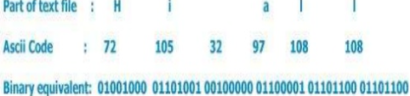
How LSB WorksStructure of text file:
Any text file consists of streams of characters , each character is 1 byte(ASCII code) each byte as all of us of course know consists of 8 bits .

Slide 10
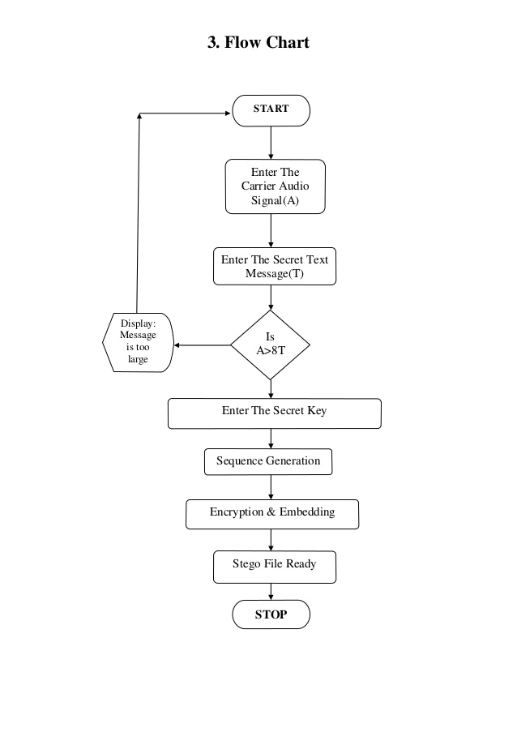
COMMUNICATION SKILLS
COMMUNICATION SKILLS
Mother tongue(s)
Other language(s)
Language 1
Language 2
Language 1
Language 2
Language 3

Slide 11
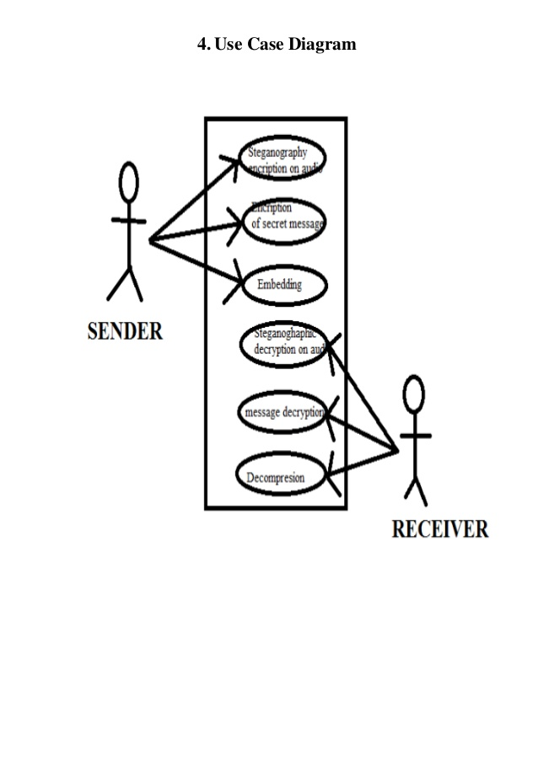

Slide 12
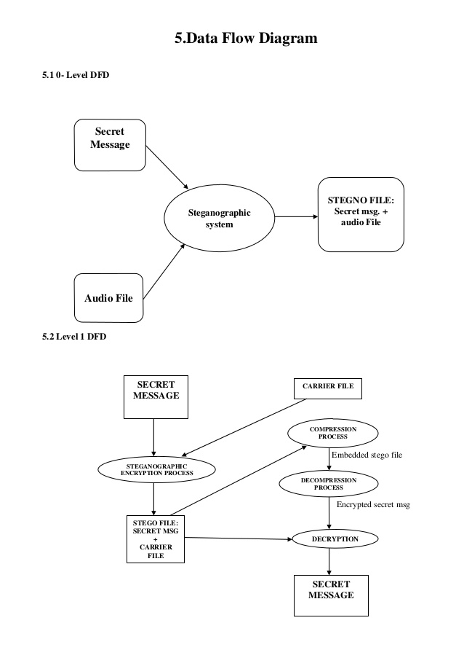

Slide 13
ENCRYPTION PHASE:The “Encryption phase” uses two types of files for encryption purpose. One isthe secret file which is to be transmitted securely, and the other is a carrier file such as image. In theencryption phase the data is embedded into the image.Figure: Encryption Phase Process
DECRYPTION PHASE:The Decryption phase is reverse to encryption phase. In decryption phase, thecarrier image in which the data is hided is given as an input file. decryption section uses the “LeastSignificant bit Algorithm” (LSB) by which the encoded bits in the image is decoded and turns to itsoriginal state and gives the output as a text document.

Slide 14
ENCRYPTING

Slide 15
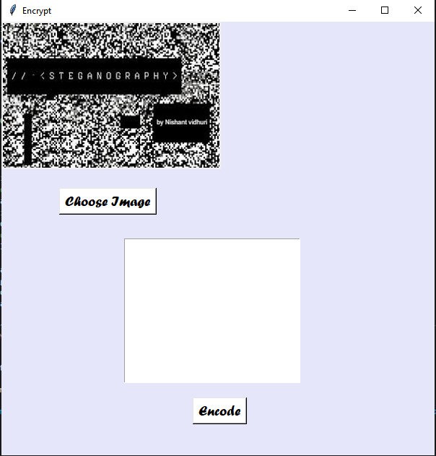

Slide 16
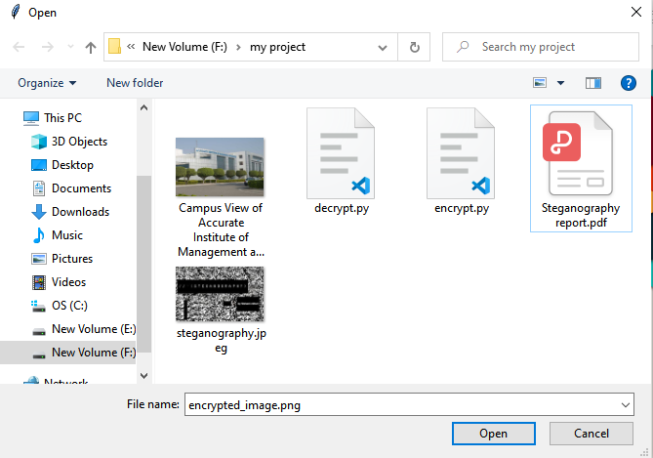

Slide 17
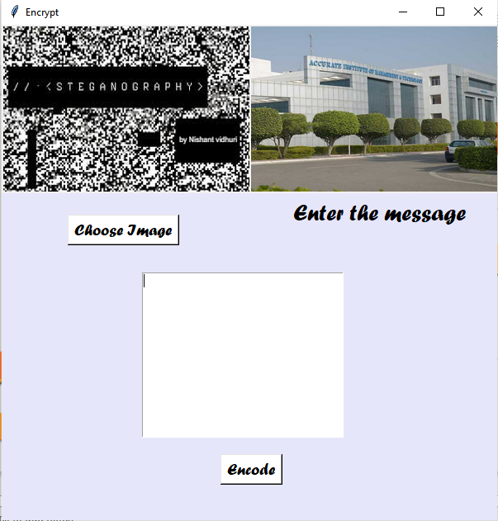

Slide 18
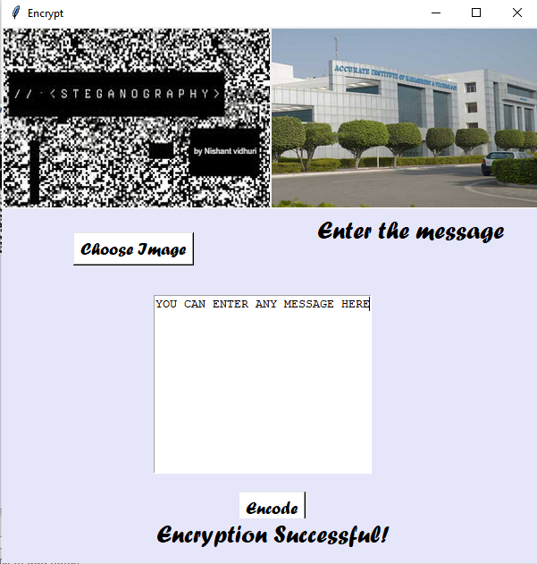

Slide 19
DECRYPTING

Slide 20


Slide 21
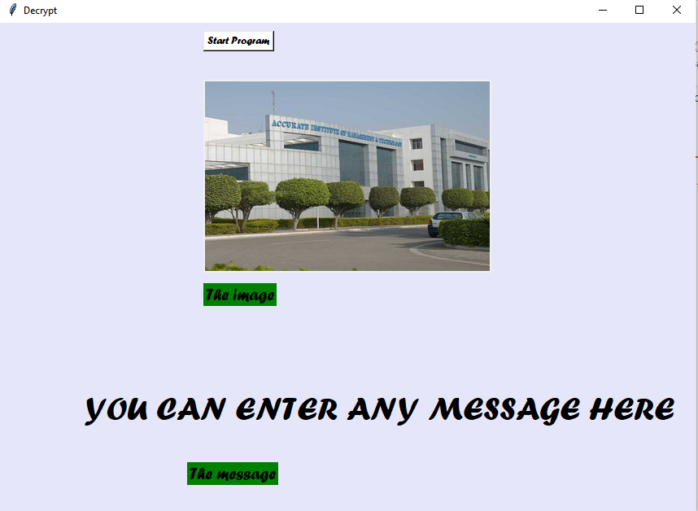

Slide 22
Result and conclution
01
02
03
04
Normally, after embedding the data into the image, the image may lose itsresolution. In the proposed approach, the image remains unchanged in itsresolution as well in size.
In this project I mainly concentrated on embedding the data into an image. Ihave designed the steganographic application which embedded the data intothe image
The speed of embedding the data into the image is also high in the proposedapproach such that the image is protected and the data to the destination issent securely
For the decryption phase, I have used the same .NET programminglanguage for the purpose of designing.

Slide 23
DIRECTORIES
PIL
CV2
Numpy
Maths

Slide 24
CONTACT
Name
Nishant Kumar Vidhuri
PHONE
9871202673
handle
@vidhurinishant321
EMAIL
nishantvidhuri0987@gmail.com

Slide 25
THANKS!

